Slide 1

Name: Dhruv Amin Subject: YWCC 307 Date: 3nd October 2023 Topic: SHORTCOMINGS OF EMBRACING BITCOIN AS FORM OF DIGITAL CURRENCY

Slide 2
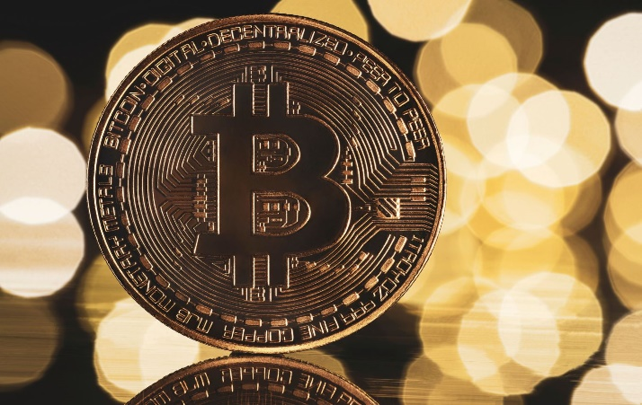

Image showing Bitcoin Logo

Slide 3

Introduction
Bitcoin is a modern digitalized form of Cryptocurrency
This digital currency is innately decentralized and virtually operated (Sparkes, 2021)
The decentralized and virtual aspects make Bitcoin operations to freely operate without being controlled by governments or traditional banking institutions (Sparkes, 2021)
Bitcoin’s operations normally utilize verified cryptography networks and an open source software to facilitate transactions (Sparkes, 2021)
Various servers across the globe act as public ledgers where users access Bitcoin’s valuation, records, and transactions
The interconnected network nodes used in various Bitcoin’s applications primarily operate by relying on digital block-chain technology (Sparkes, 2021)
Generally, Bitcoin's decentralized aspects, virtual operations, and block-chain technology make it unreliable when conducting modern trade deals or making future investments.

Slide 4
Main Argument and Full Thesis Statement
The main argument is; Bitcoin should not be fully embraced as a global currency when performing trade deals or pursuing future investments
Bitcoin is the most established and highly valued cryptocurrency existing in the contemporary global market (Author, 2022)
Bitcoin’s intrinsic value is justified by its current high capitalization of approximately USD $825.61 billion (Author, 2022)
The high capitalization value makes Bitcoin the most reliable cryptocurrency when investing financial resources
Bitcoin cryptocurrency is well-established because; it was the first to be founded in 2009 (Author, 2022)
The widespread recognition makes most investors, business entities, plus financial institutions around the globe to favor Bitcoin as the most reliable cryptocurrency when conducting business transactions
FULL THESIS STATEMENT- Although Bitcoin is a highly valued, well-recognized, and revolutionary form of modern currency that limits governments plus banking institutions from completely controlling the global financial system, it should not be fully embraced as a transaction means because; the decentralized aspects, virtual operations, and block-chain technology can often instigate operational challenges, security risks, plus transactional shortcomings when using this cryptocurrency when making future investments or trading various commodities. The limitations and drawbacks associated with Bitcoin are primarily prompted by prevailing; social, ethical, security, or technological issues.

Slide 5
Reasons and Supporting Statements Justifying the Main Argument
Most individuals are socially conditioned to use hard currency because; Bitcoin is a relatively new means of making transactions
This social inclination makes most businesses and consumers to disregard adopting most digital currencies like Bitcoin (Author, 2022)
The anonymity guaranteed when using Bitcoin can be used to finance illegal activities (Prasad, 2021)
Some illegal activities financed by Bitcoin include; smuggling, drug trade, terrorism, plus other organized crimes
These illegal operations can easily endanger innocent civilians
Bitcoin transactions might escalate the problem of tax evasion (Author, 2022)
Tax evasion can make governments around the globe to lose significant revenues
Bitcoin’s networks can be susceptible to ransomware, hacking, or cyber theft (Prasad, 2021)
This can make Bitcoin users to lose a lot of money
Most people cannot understand Bitcoin’s technologies like block-chain processes and data mining operations

Slide 6
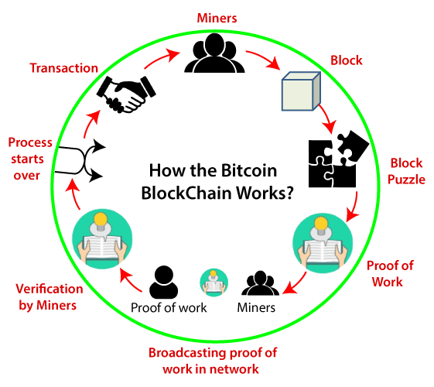
Image showing Bitcoin’s data-mining and block-chain processes

Slide 7
Other Supporting Statements
As the number of Bitcoin users increased the platform became extremely difficult, expensive, and slow (Prasad, 2021)
These problems can make Bitcoin unreliable when conducting business operations
Government security agencies have successfully breached Bitcoin’s secure network to track criminals (Prasad, 2021)
Breaching Bitcoin’s network makes users to avoid this platform when making monetary transactions
Bitcoin’s unregulated aspects makes it extremely volatile during difficult economic periods
This volatility often makes investors to make loses
Bitcoin’s computing processes and data mining operations require a lot of electric energy; this makes Bitcoin unsustainable for humans

Slide 8
Counterarguments
Bitcoin can act an excellent platform when performing future transactions
As a digital currency, Bitcoin can eradicate traditional printed notes and coins
By embracing Bitcoin transactions, normal consumers and potential investors can operate without any government restrictions
These restrictions are mitigated because Bitcoin’s virtual existence plus decentralized aspects prevents powerful financial entities or financial officers in government from controlling global financial systems
Technologies utilized in Bitcoin’s operations like block-chain, Artificial Intelligence, and data mining can enable future humans develop mind-blowing digitalized platforms or other autonomous applications

Slide 9
Conclusions
Bitcoin's decentralized aspect and virtual operations have numerous drawbacks
The decentralized nature of Bitcoin makes this digital currency to be extremely unstable and volatile
Bitcoin’s virtual operations are not widely embraced in most societies globally; this makes most individuals to continuously use bank-controlled currency
The anonymity guaranteed when using Bitcoin can limit public safety by enabling criminal gangs, terrorists, or other malicious people to finance their operations without being detected
Most people do not understand Bitcoin’s technologies like data mining and block-chain processes; this can dissuade people from embracing Bitcoin transactions
Bitcoin’s network can potentially expose innocent users to cyber theft, hacking, and ransomware; this can make them lose money

Slide 10
References
Author, A. (2022). What are the challenges associated with Bitcoin and its future? Published by Tetra Consultants. Retrieved From: https://www.linkedin.com/pulse/what-challenges-associated-bitcoin-its-future-arthur-ang
Prasad, E. (2021). The brutal truth about Bitcoin. Published by The New York Times. Retrieved from: https://www.brookings.edu/articles/the-brutal-truth-about-bitcoin/
Sparkes, M. (2021). What is bitcoin and how does it work. New Scientist. Retrieved from: https://www.newscientist.com/definition/bitcoin/
https://www.google.com/search?q=bitcoin+data+mining&sca_esv=569774734&tbm=isch&sxsrf=AM9HkKlIqgP_TvjQltpXUNh78QhQ8xNzNQ:1696118046538&source=lnms&sa=X&ved=2ahUKEwjxwaSNxNOBAxVMSvEDHXU3BcUQ_AUoAnoECAEQBA&biw=1366&bih=651&dpr=1#imgrc=1vgw76nRt8r5DM&imgdii=ihAWqlblLgzlUM

